Slide 1

Amazon Comprehend
Exam Overview

Slide 2
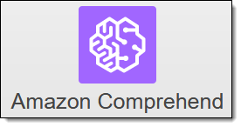
Amazon Comprehend
What is it?
A machine learning driven service that allows you to discover insights and relationships in text

Slide 3
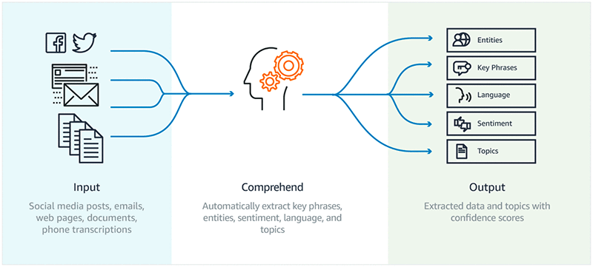
Powered by Natural Language Processing (NLP)

Slide 4
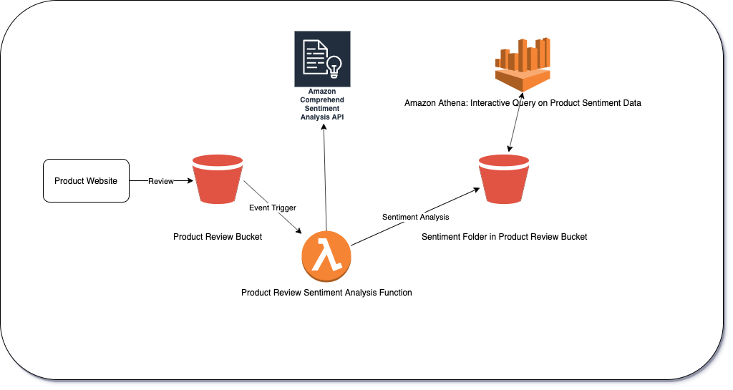
Use Case
Product Reviews

Slide 5
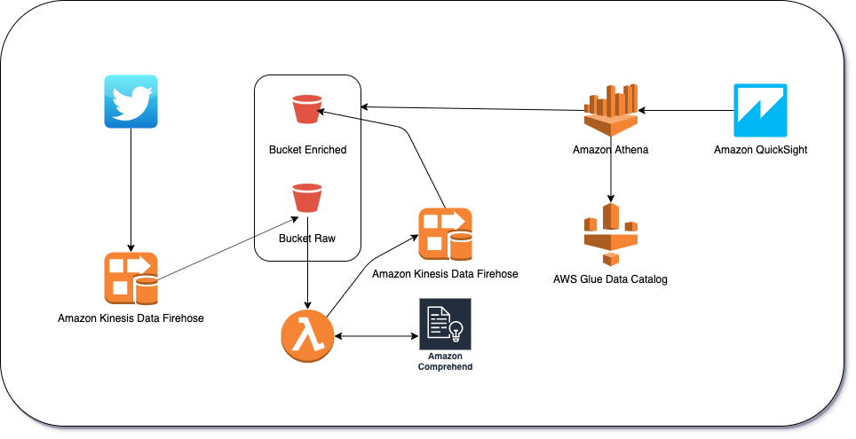
Use Case
Social Media Feeds

Slide 6
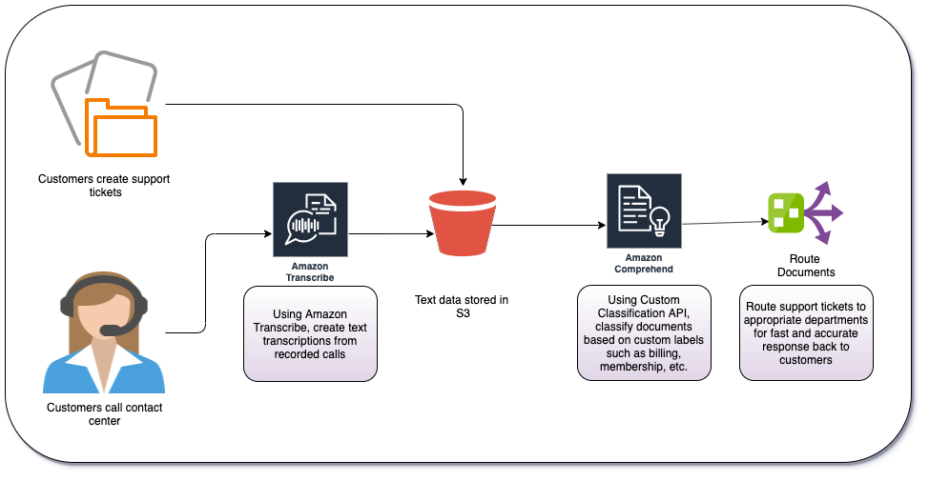
Use Case
Customer Support Incidents

Slide 7
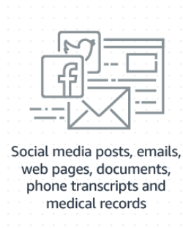
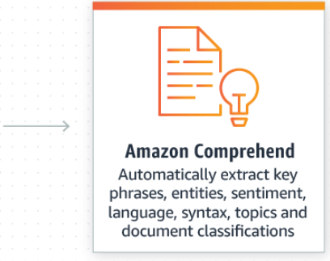
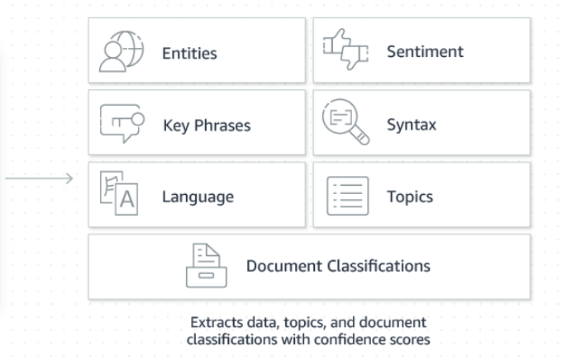
Amazon Comprehend
How it works

Slide 8
Amazon Comprehend
Exam Notes
Uses a pre-trained model to analyze a document(s) to gather insights.
The model is continuously trained on a large body of text; you don’t need to provide training data.
With Amazon Comprehend, you can perform the following on your documents:
Detect the Dominant Language — Examine text to determine the dominant language.
Detect Entities — Detect textual references to the names of people, places, and items as well as references to dates and quantities.
Detect Key Phrases — Find key phrases such as "good morning" in a document or set of documents.
Determine Sentiment — Analyze documents and determine the dominant sentiment of the text.
Analyze Syntax — Parse the words in your text and show the speech syntax for each word and enable you to understand the content of the document.
Topic Modeling — Search the content of documents to determine common themes and topics.

Slide 9
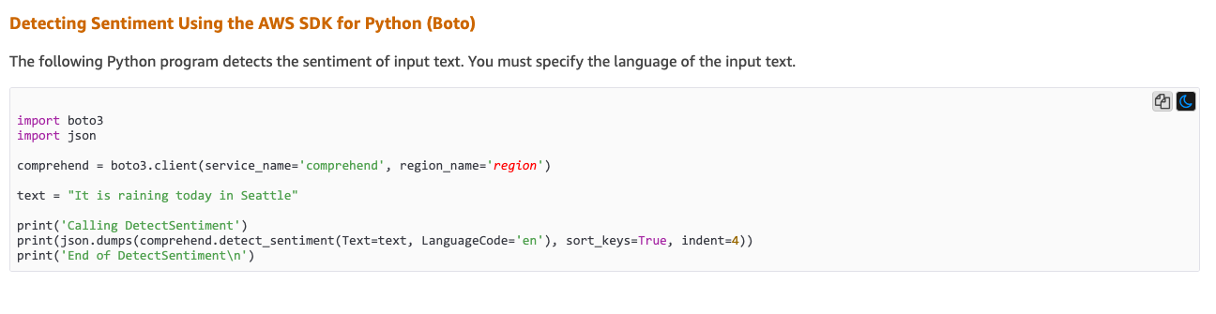
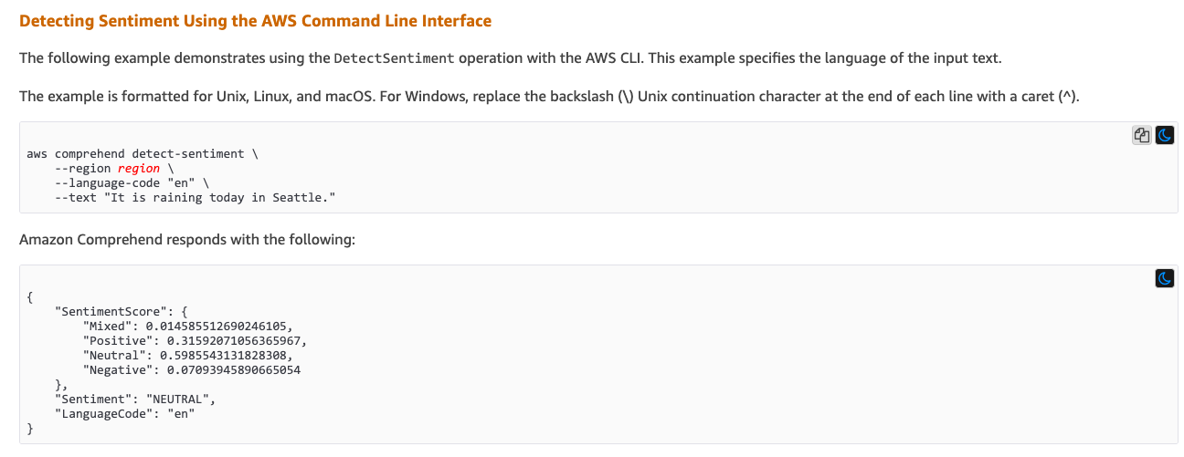
Demo
Python API and CLI

